Slide 1


Navigating the Global Cost of Living Landscape
Understanding the cost of living across different cities and countries is crucial for individuals and businesses making important decisions, whether it's choosing a place to live, expanding operations, or planning a global relocation. This in-depth analysis delves into the nuances of cost-of-living data, providing a comprehensive overview of the economic factors that shape the global landscape.
by cynthia nyahoda

Slide 2

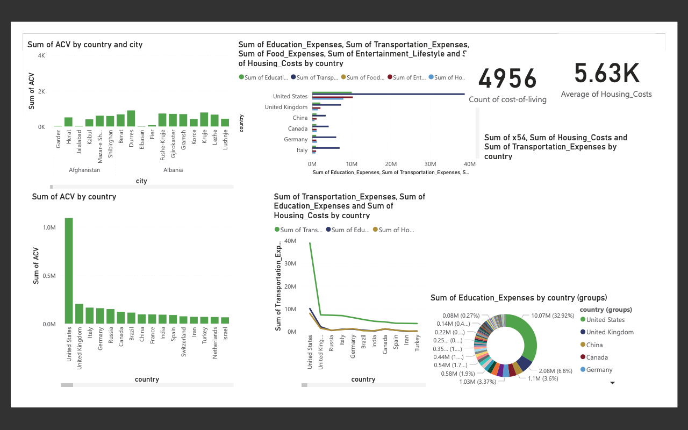

Slide 3
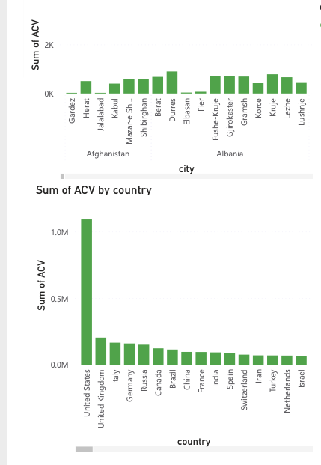

Uncovering the Highest and Lowest Cost of Living
Highest Cost of Living
Lowest Cost of Living
The data reveals that the cities with the highest cost of living are often major global hubs, such as those that are in the United states. These cities command a premium due to factors like high housing costs, limited space, and the concentration of lucrative industries and job opportunities.
In contrast, the cities with the lowest cost of living are typically located in developing or emerging economies, where the costs of basic necessities, housing, and labor are relatively lower. Examples include cities in countries like India, Vietnam, and parts of Eastern Europe.

Slide 4
Dissecting the Cost Components
Food and Beverages
Transportation
Housing
The cost of food and beverages varies significantly across different regions, with factors like local production, import taxes, and cultural preferences playing a major role. Certain cities, particularly those with a high cost of living, often have a premium on grocery and dining expenses.
The cost of transportation, including public transit, fuel, and personal vehicle ownership, can be a significant factor in the overall cost of living. Cities with well-developed public transportation networks and accessible infrastructure tend to have lower transportation costs.
Housing costs, including rent, mortgage payments, and utilities, are often the largest contributor to the cost of living in many cities. The availability of affordable housing and the proximity to employment hubs can greatly impact this category.

Slide 5
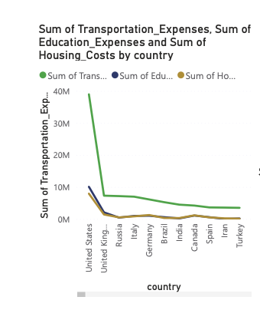
Correlating Cost of Living with Other Factors
Cost of Living vs. Salary
Cost of Living vs. Housing
The data shows a positive correlation between the average cost of living and the average monthly net salary in a given location. This suggests that higher-cost cities often offer higher incomes, but the increase in salary may not always keep pace with the rising costs.
As expected, the cost of housing is a significant driver of the overall cost of living. Cities with high housing costs, such as those in developed economies, tend to have a higher average cost of living compared to areas with more affordable housing options.

Slide 6
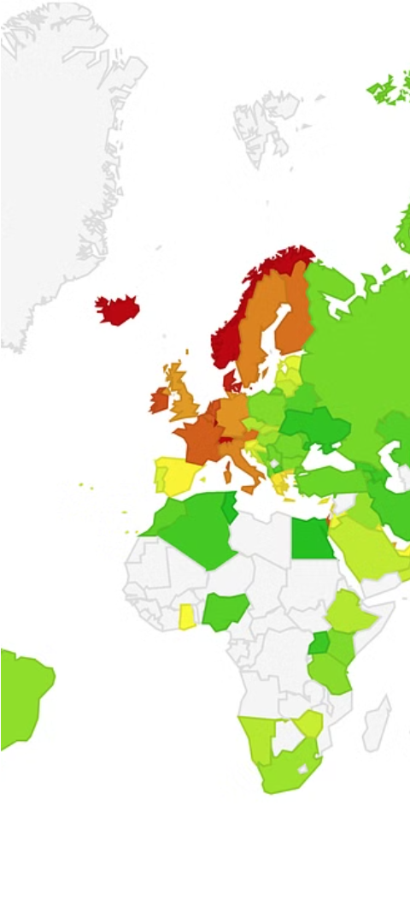
Exploring Global Cost of Living Trends
1
Rising Costs in Developed Economies
Driven by factors like limited housing supply, high taxation, and the concentration of high-paying industries, developed economies have seen a steady increase in the cost of living over the past decade. This trend has made it increasingly challenging for individuals and families to maintain a comfortable standard of living.
2
Emerging Market Opportunities
In contrast, many emerging and developing economies have experienced a relatively slower rise in the cost of living, presenting attractive opportunities for individuals and businesses looking to leverage lower costs and a growing consumer base. This trend has contributed to the ongoing shift in global economic power.
3
Changing Priorities and Lifestyle Preferences
The COVID-19 pandemic has also influenced cost of living patterns, with a greater emphasis on remote work, flexible living arrangements, and the prioritization of quality-of-life factors. This has led to a reevaluation of traditional cost-of-living hubs and the emergence of new, more affordable centers of economic activity.

Slide 7
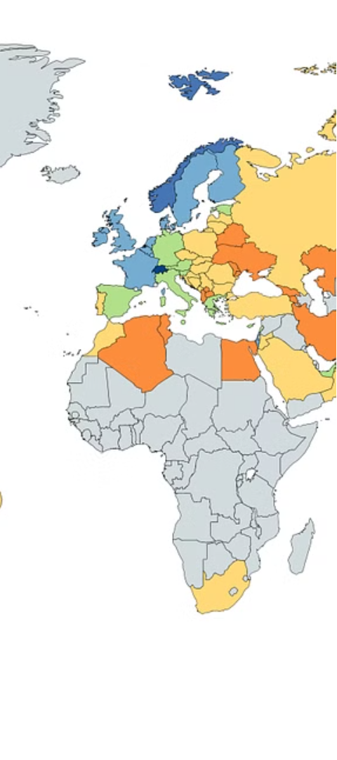
Comparing Cost of Living Across Countries
1
Developed Economies Lead
2
Emerging Markets Lag Behind
The data shows that developed economies, such as Switzerland, Norway, and Iceland, consistently rank among the countries with the highest cost of living. This is largely due to factors like high taxation, strong economic development, and a concentration of high-paying industries and jobs.
In contrast, emerging economies, particularly in Asia and parts of Eastern Europe, tend to have a significantly lower cost of living. Factors like lower labor costs, less stringent regulations, and a growing consumer base contribute to this trend, making these regions attractive for both individuals and businesses.
3
Variations Within Regions
It's important to note that the cost of living can vary significantly even within the same region or country, with factors like urban vs. rural areas, availability of resources, and local economic conditions playing a crucial role in shaping the overall cost landscape.

Slide 8



Navigating the Cost of Living through Data-Driven Decisions
Comprehensive Data Analysis
Tailored Geographical Insights
Financial Planning and Budgeting
By conducting a thorough analysis of cost-of-living data, individuals and businesses can make informed decisions about their location, investments, and overall financial planning. This data-driven approach helps identify the most cost-effective regions and highlight potential areas for optimization.
Understanding the cost of living dynamics in specific cities and countries is crucial for making strategic decisions. Leveraging geographical insights can help individuals and organizations find the most suitable locations that align with their budgets and long-term goals.
Analyzing the cost of living data can provide valuable insights for personal and business financial planning. This information can help individuals and organizations budget more effectively, allocate resources efficiently, and make informed decisions about investments, relocation, and expansion.

Slide 9

Conclusion: Empowering Informed Decisions
The analysis of global cost-of-living data has revealed a complex and dynamic landscape, shaped by a multitude of economic, social, and geographical factors. By understanding these trends and patterns, individuals and businesses can make more informed decisions about their location, investments, and overall financial well-being. This knowledge empowers stakeholders to navigate the global landscape more effectively, seize opportunities, and optimize their resources to achieve their goals.

